Slide 1
BLACKJACK
Carlos Mercado, Edgar Renteria, Jordan Nicholls, Maria Guimaraes-Diniz-Tomaz

Slide 2
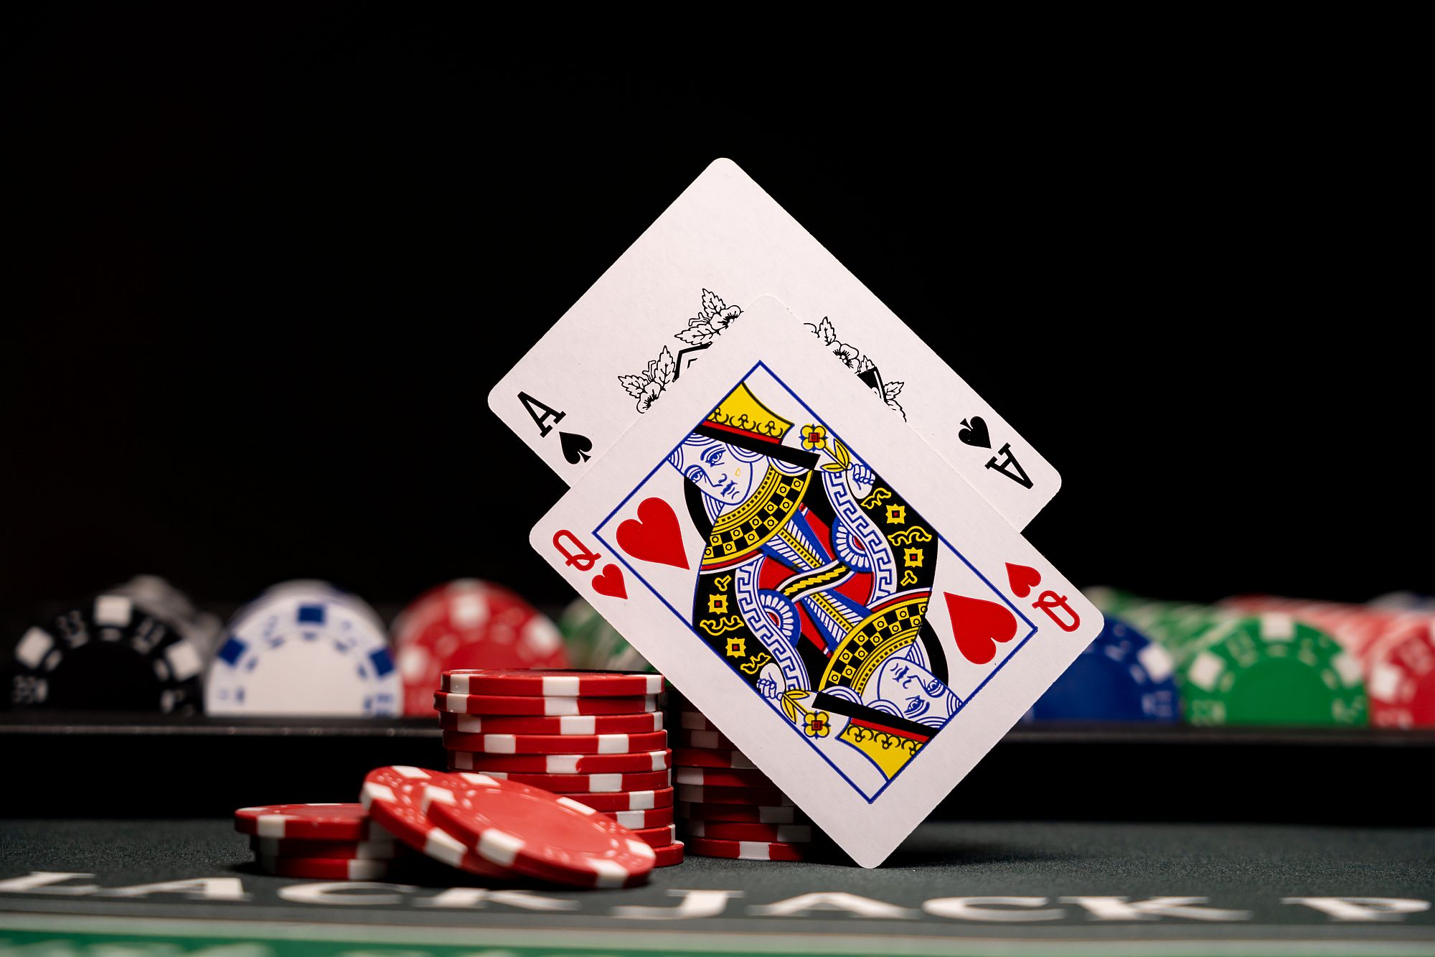

MOTIVATION
Blackjack is a very popular game
Monte Carlo Method simulation provides a powerful tool to optimize strategies
Powerful for understanding of the concept of optimal strategies
The movie “21”.

Slide 3
Problem Statement
Write a Monte Carlo script to evaluate five MC policies.
What is the optimal winning policy?
Evaluate 5 different policies
In different version of the game (different decks)

Slide 4
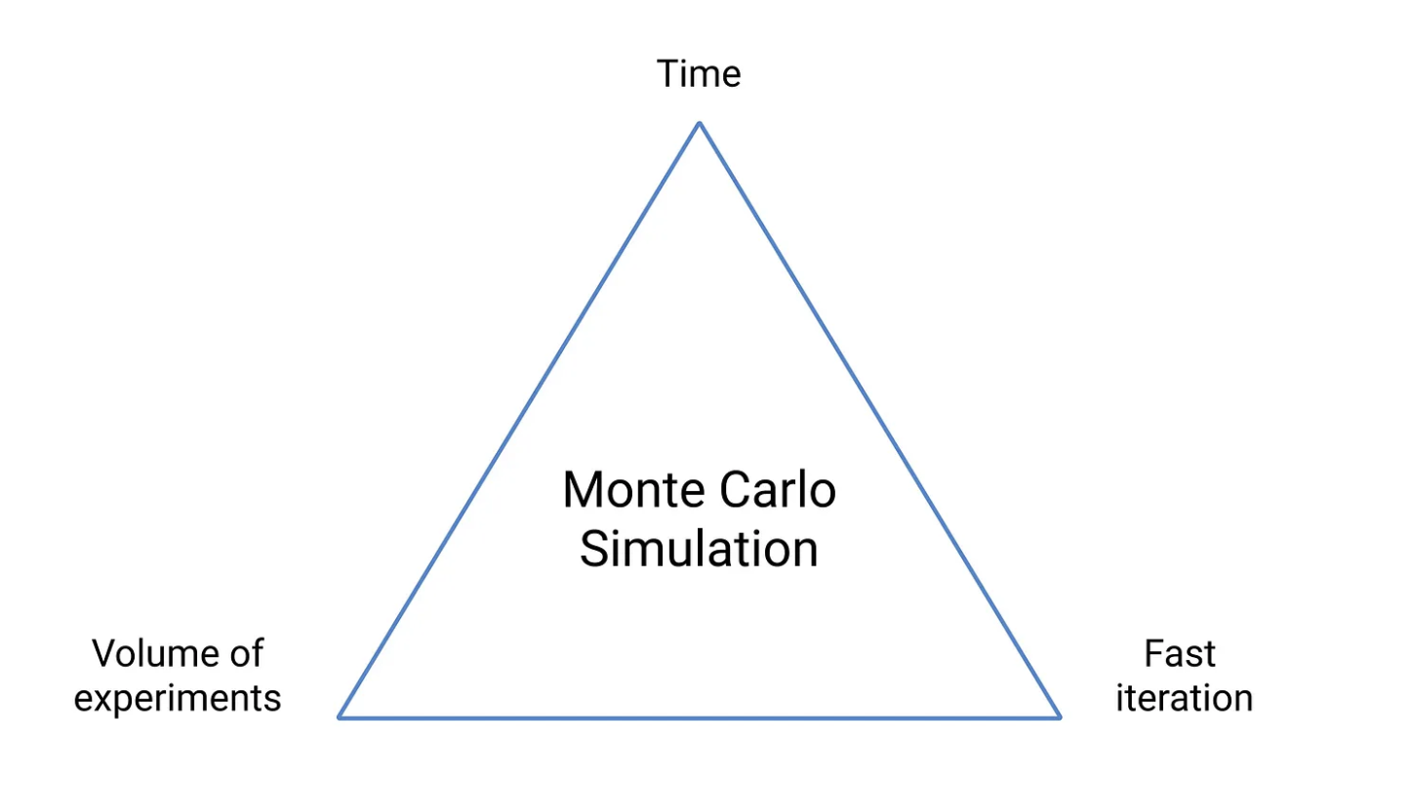
Monte Carlo Methods
BACKGROUND
Use of experience — sequences of states, actions and gains from interacting with the environment or from simulations to predict uncertain events
Good for large amount of Random samples (generating random hands for players and dealer)
-> Action
-> Policy
-> Returns
-> Exploration phase
->Policy evaluation
-> Result

Slide 5
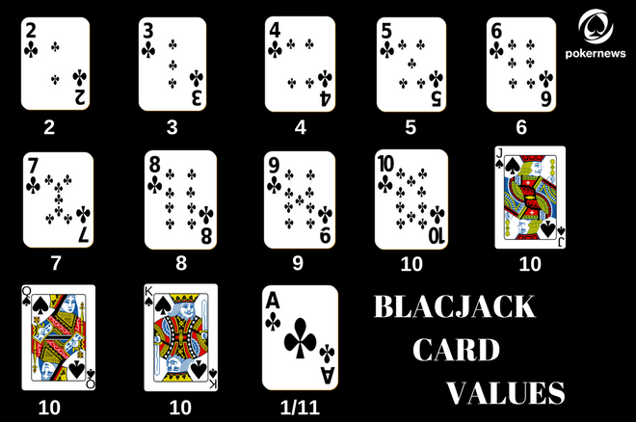
Rules
OBJECTIVE: A player try to obtain cards whose sum of their numbers is as close to 21 as possible, but without exceeding this value.
DECK TYPES:
Single deck (Single) of 52 playing cards (if card drawn cards total decreases)
Infinite deck (multiple) - (Deck never decreases)
CARD VALUES:
Notes:
motivation, probelm statemente, work relatet black jack strategies - count wins / total of games single dack avarage and multiple

Slide 6

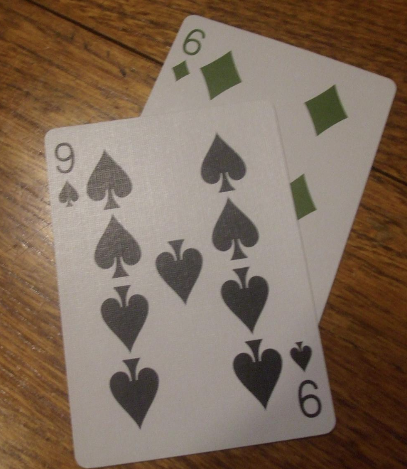
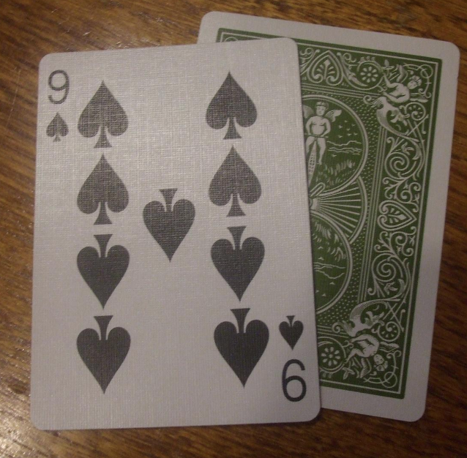
Banking game players: PLAYER and DEALER
PLAYER: start with a hand with two up cards.
DEALER: start with a hand with two cards (up/down).
KEYS:
HIT (draw a card from the deck)
STICK (stop drawing)
BUST (If the sum of the values exceeds 21, you loose)
SOFT (any hand with an ACE except Blackjack)
BLACKJACK (If the first to drawn two cards get a
hand value of 21: win)

Slide 7
Policies
Policy 1: if your hand ≥ 17, stick. Else hit.
Policy 2: if your hand ≥ 17 and is hard, stick. Else hit unless your hand = 21.
Policy 3: Always stick
Policy 4: Hand < 21, Hit
Policy 5: Hit until face card.
Notes:
5 rules!!!

Slide 8
Blackjack Monte Carlo Implementation
LANGUAGE: PYTHON
Give the dealer two cards, and give the player two cards.
Add up both the dealer and the player cards.
Check for blackjacks for player and dealer
For given policy, add cards, or stay.
After staying, append cards to dealer hand until their hand sums to 17 or greater.
If dealer is over 21. Bust, dealer loses.
Winner is the person who has the greatest sum of cards at this point.
Repeat for multiple iterations.
The expected rewards for each policy will be calculated by averaging the rewards over all the interactions of the simulation.

Slide 9
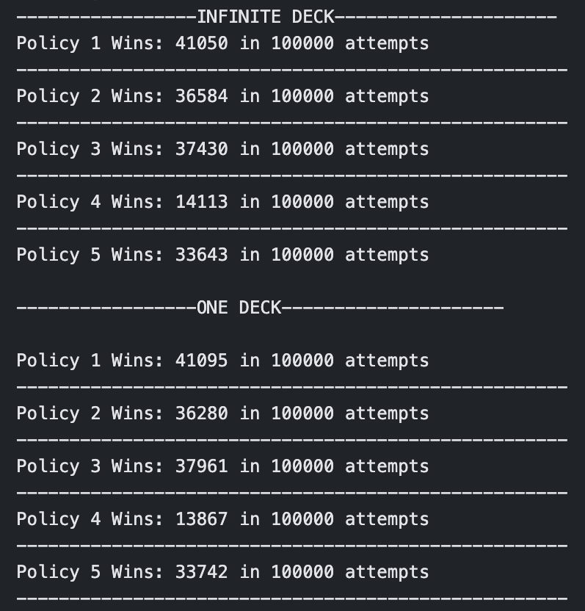
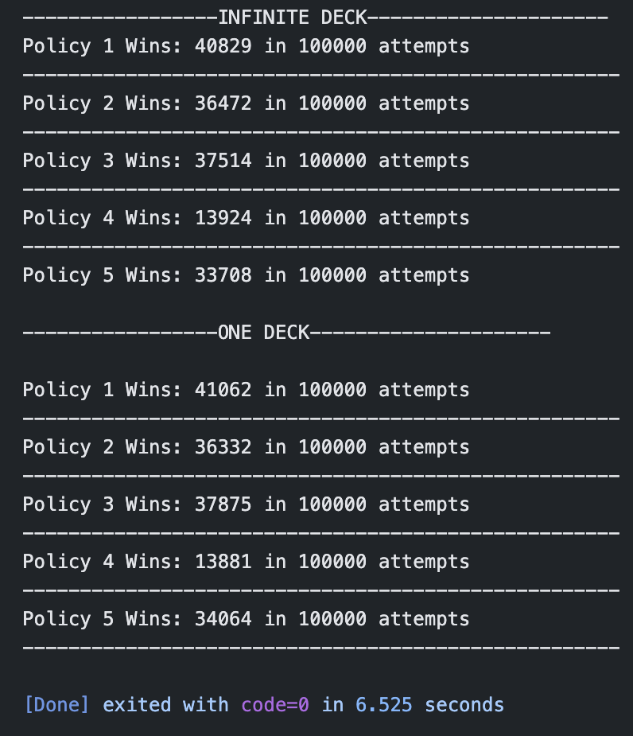
Blackjack Monte Carlo Implementation

Slide 10
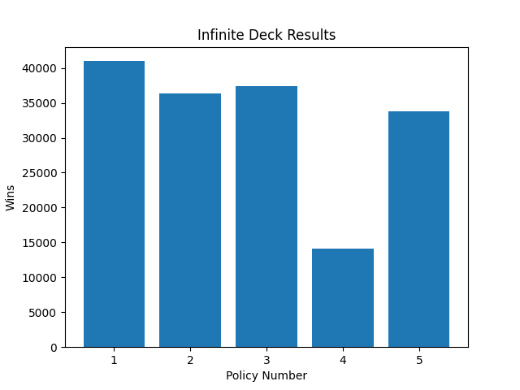
Results/Discussion
From the results we can see that policy 1 (stay if hand >= 17 else hit), is the best approach of the 5 for infinite decks.
The worst approach is not surprisingly approach 4 (hit until 21).

Slide 11
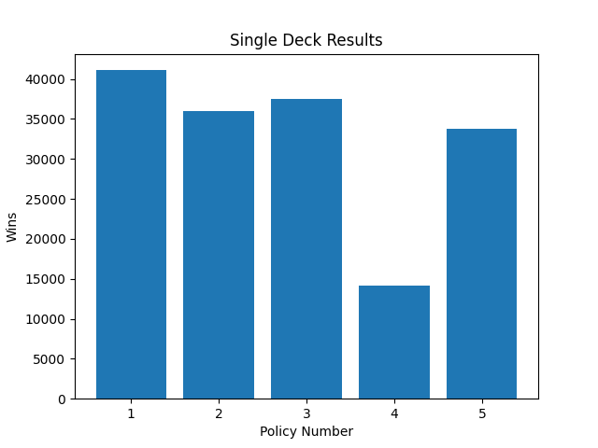
Results/Discussion
Just like the infinite deck approach, policy number one is the best of the five.
Worst approach is still policy 4.
Notes:
visualize variants for the police (

Slide 12
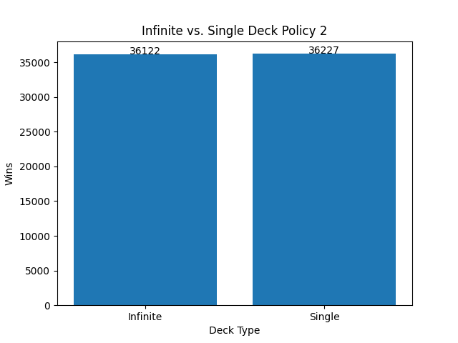
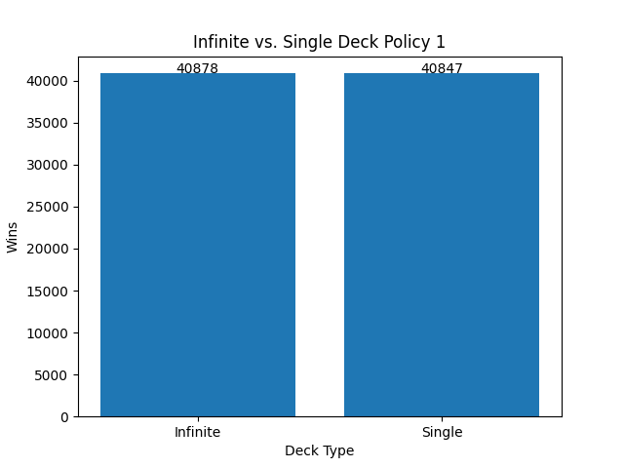
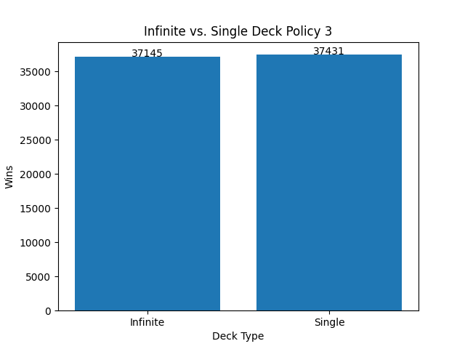
Results/Discussion (Inf vs. Single Deck)
Very small differences in wins in the different deck approaches.

Slide 13
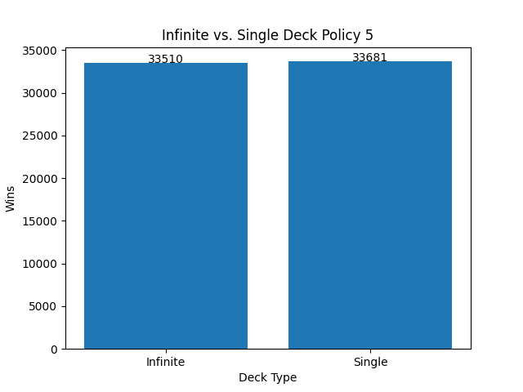

Results/Discussion (Inf vs. Single Deck)

